Slide 1
Covid-19 Impacts on Education
Sentiment Analysis using Natural language processing methods
Author: Nasibullah Qarizada
Instructor: Fatma Patlar Akbulut
Lecture: Artificial Intelligence, CSE0440

Slide 2
Overview
Gathering Dataset
Pre-Processing Dataset
Feature Engineering
Sentiment Analysis
Training data and comparing with Pre-trained.
Results

Slide 3
Introduction
Covid-19 has changed everyone's traditional life.
Education is among most affected sections, which raised worries of lots of stakeholders.
Students and teachers are facing serious problems, such as financial, social and psychological.
Researchers started analyzing situations to define problems and search in ways of reducing them.
This research contains sentiment analysis of 10,000 tweets.

Slide 4
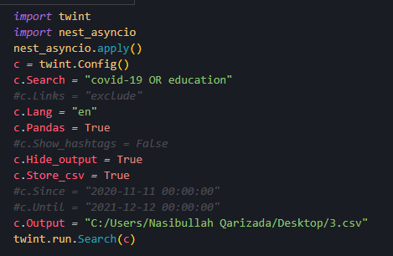
Fetching Dataset
Twint is an API, used for a gathering data from twitter.
It has filtration method properties, which makes it easy for pre-processing.
We’ve been succeeded to gain 10,000 tweets to continue our research.

Slide 5
Pre-Processing
Pre-processing is the second step and unescapable part of data analyzing.
It is basically the operation of cleaning the gathered data.
A study on 2016 showed that data scientists spend 60% of their time doing pre-processing.
TextBlob, neattext and NLTK is some of Pre-Processing libraries and been used in this research
Some of Pre-Processing methods has been shared below:

Slide 6
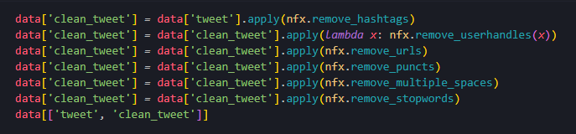
Pre-Processing

Slide 7
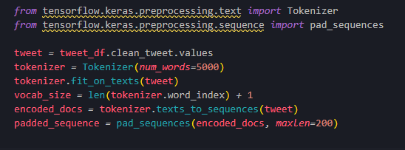
Feature Engineering
Feature Engineering is the process of selecting, manipulating and transforming raw data into that can be used in supervised learning.
BOG, TF-IDF and Word2Vec is most usable methods.

Slide 8
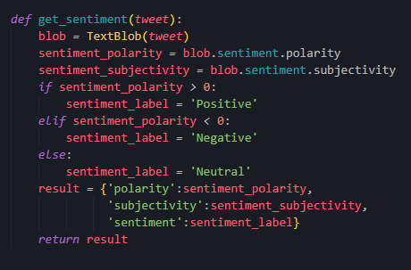
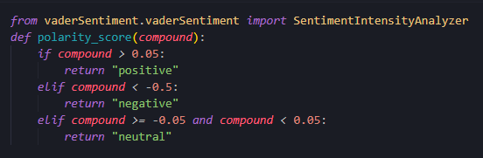
Sentiment Analyzes
Sentiment Analyzes is the method of classifying the data into Positive, Negative and neutral forms.
TextBlob and Vader is most used of them, which has been also used in this project.

Slide 9

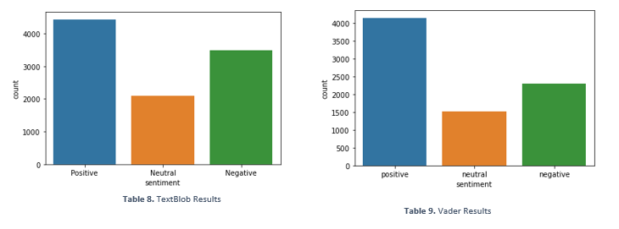
Sentiment Analyzes
TextBlob and Vader Results:

Slide 10
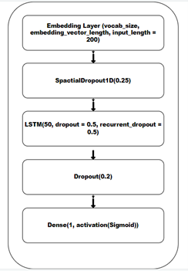
Training and testing data
The dataset has been trained with 3 models, consist of: LSTM, CNN and RNN.
Below is the LSTM model and result of different models on research.
 | LSTM | CNN | RNN
TextBlob | 0.51 | 0.97 | 0.81
Vader | 0.48 | N/A | N/A

Slide 11
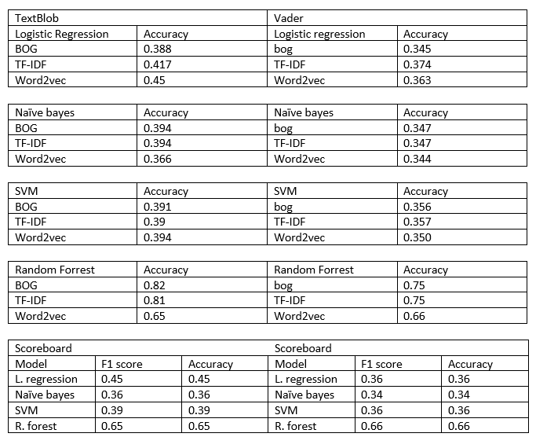
Training and testing data
We’ve also trained the dataset with pre-trained models.
Logistic Regression, Random Forest, Support Vector Machine and Naïve Bayes.

Slide 12
Conclusion
Even if Covid-19 has been spreaded 3 years before, and the vaccine is out; The negative effects continues.
The data has been gathered from twitter with the help of Twint API.
Pre-processing and feature engineering methods has been applied in case to achieve sharp results.
TextBlob and Vader used to analyze and classify overall emotions of people regarding to changes.
And as last step model has been tested in cases of trained (LSTM, CNN and RNN) and pre-trained (LR,RF,SVM and Naïve bayes).
And we noticed that the number of negative tweets were higher.

